Slide 1
NOTES ON USER FLOW for development and pitch

Slide 2
USER FLOW Connected TV app

Slide 3
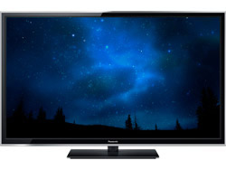

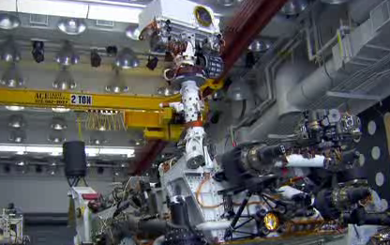
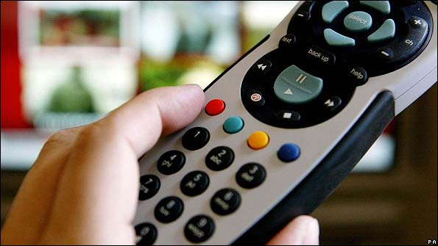
LAUNCH APP
Continuity announcement
In programme easter eggs
Icon in credits
Presenter CTA
Advertising in iPlayer
M&A advertising, like iPlayer
Viewer is regular user
WATCHING TELLY
Keyword look-up frozen for the first 3 minutes of the programme to allow the user to ‘get absorbed’ in the on screen content
“…they'll be doing it for real, hoping the Curiosity rover will arrive safely at its destination”
App recognises keyword in subtitles
‘Spark bulb’ icon appears in the right hand corner of the screen
User can choose to ignore this spark, which disappears after 10 seconds.
User accesses spark via the red button
If a new keyword is triggered within 10 seconds, the associated content will appear in the side bar, but it will not trigger another alert icon
Notes:
Launching the app:
Continuity announcement
“…Horizon follows NASA’s latest mission to investigate the possibility… Remember to turn on your connected TV app for…”
In programme easter eggs
Find out more about something/ the result of something in the programme by accessing the app
Advertising campaign via iPlayer
Pre- or post-programme
By providing the option to access content associated with a programme via the iPlayer page > becomes a feature integrated into each iPlayer page (constant exposure…)
On screen CTA - offering recipes etc via the service (success with Science Club)
Through presenter CTA
On screen watermark
Keyword look-up frozen for the first 3 minutes of the programme to allow the user to ‘get absorbed’ in the on screen content – does this change with duration of programme?
App recognises keyword in subtitles – more information
Spark icon?

Slide 4
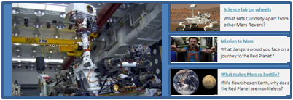

Screen shrinks so the flow of broadcast is not interrupted.
Sidebar appears with guide option(s) associated with that spark
User uses remote to browse guide options (max 3 per keyword) and clicks on a guide in which they are interested.
User has the option to dismiss the guide or add it to their binder – using the coloured buttons.
SAVE
MAIL
SAVE ALL
User chooses to dismiss
Once accepted, MSG tells user that the guide has been successfully added to their binder/emailed.
N.B. User can scroll through previous guides and choose to add any to their binder
SUCCESSFULLY SAVED TO BINDER
Sidebar closes and full screen is restored. Sidebar is accessible at all times via the red button, even when the icon is not visible

Slide 5
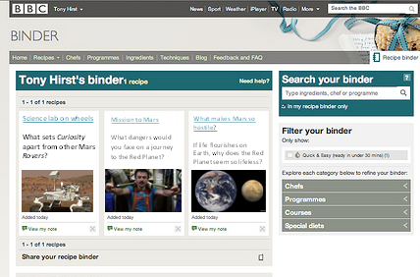
User can return to full screen via the red button.
User can review their saved guides at any point during the programme – with the options to navigate between guides and SHARE, MAIL or DELETE a guide.
N.B. Once a keyword has activated the spark, the same keyword will be frozen for the rest of the programme.
END OF PROGRAMME:
App prompts user to review saved guides
User can navigate between guides using the arrows on their remote
User can DELETE a guide, SHARE a guide on Twitter or Facebook, EMAIL a guide, or opt to VIEW a guide in their browser now the programme has finished
User can also choose to e-mail themselves their latest ‘saves’ or turn off e-mail reminders
Binder automatically update with new guides – syncs across connected TV app, browser and iPhone/iPad/Android app (optional)
Users can close the homepage but the app keeps running
Notes:
OPTION TO REVIEW SAVED ITEMS DURING PROGRAMME: SHARE, MAIL, DELETE (RETURN ICON SYNC’D WITH BACK BUTTON)

Slide 6
USER FLOW Review binder and online learning journey

Slide 7
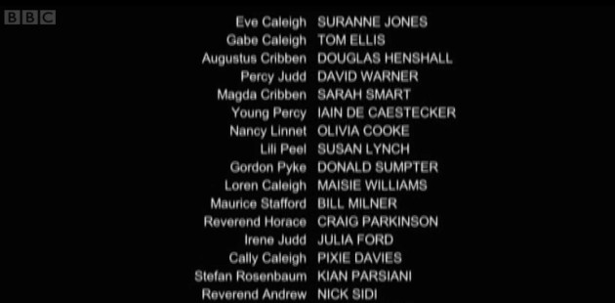
BINDER
END OF PROGRAMME:
App prompts user to review saved guides in their binder
User accesses their binder via the red button, which takes up entire screen. Audio continues.
Newly saved guides show at the top – user can navigate between these using the arrows on their remote
VIEW
User can view guide in
their browser
SHARE
User can share guide via
email, Facebook or Twitter
USERS CAN ALSO
choose to e-mail themselves their latest ‘saves’
turn off e-mail reminders
look at previously saved guides
SAVE ALL
User can choose to save all
remaining guides
DELETE
User can delete unwanted
guides

Slide 8

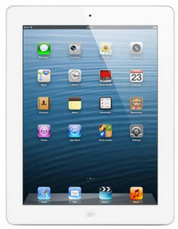
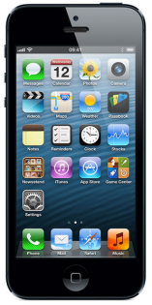
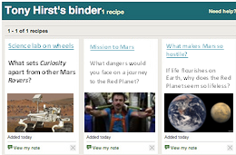
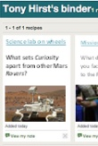
User closes the binder but the app continues to run in the background
Binder automatically syncs across connected TV app, desktop (via browser) and iPhone/iPad/Android app (optional)
iPhone/iPad/Android app notifies user that there is new content saved in their binder. They can also choose to view or share content via the app.
ONWARD JOURNEY

Slide 9
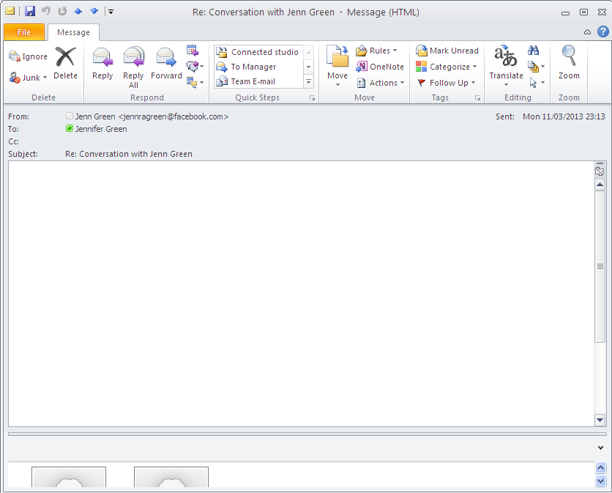
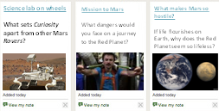
FOLLOWING DAY:
Unless the user has opted out of email notifications they will receive a summary of the content they have saved to their binder
Title is personalised, e.g. While you were watching “Wonders of Life” you grabbed these items…
Minimal, personalised copy…
Only one reminder per day & only if new guides have been saved
Content appears like promo in binder (not spam like).
Clickable images and copy
Binder
ONWARD JOURNEY
Link to access binder
ONWARD JOURNEY

Slide 10
PITCH
Hook in one line that sums up strong audience offer
User flow including:
Why would they activate the app?
More on keyword > relevant K&L content
How are relevant guides found and surfaced at the right times? How much of this can be automated?
Focus on review section - detail on how we would encourage them to make an onward journey. What types of onward journey could they make?
3 examples: (1) Mission to Mars guide > view through connected TV browser, (2) Recipes > smartphone app in supermarket), (3) Africa > User doesn’t have time to finish the programme but interested in the content > opts to save all to binder before switching off > email notification the following day provides them with content about spp in the Congo covered by the programme (also provides link to catch up)
Mock up email (developer)
How does the reminder we send users spark their curiosity beyond a simple reminder?
Include examples of audience testing (studio and behaviour during Science Club/ Wonders)
Explanation of what we would build if we took this to pilot
Migrate concept onto connected TV
Test automated version using look up tables (?),
Audience test with full programmes / different genres
Extension of original concept
E.g. could the user subscribe to all the guides for a programme or series, so that they were automatically added to their binder as the programme TX – even if they aren’t watching the programme.
E.g. could the app be integrated into iPlayer. Even if it’s as a link that allows the user to add a guide/all guides to their binder.
Notes:
AUDIENCE TESTING: How will we regulate the number of keywords that provide a hit within each programme? E.g. max 12/hour. AS MUCH SURFACE AS POSSIBLE? OR RANK RELEVANCE OF KEYWORDS? FREEZE ICON AFTER ALERT, BUT KEEP FEED CONTINUOUS?

